Slide 1
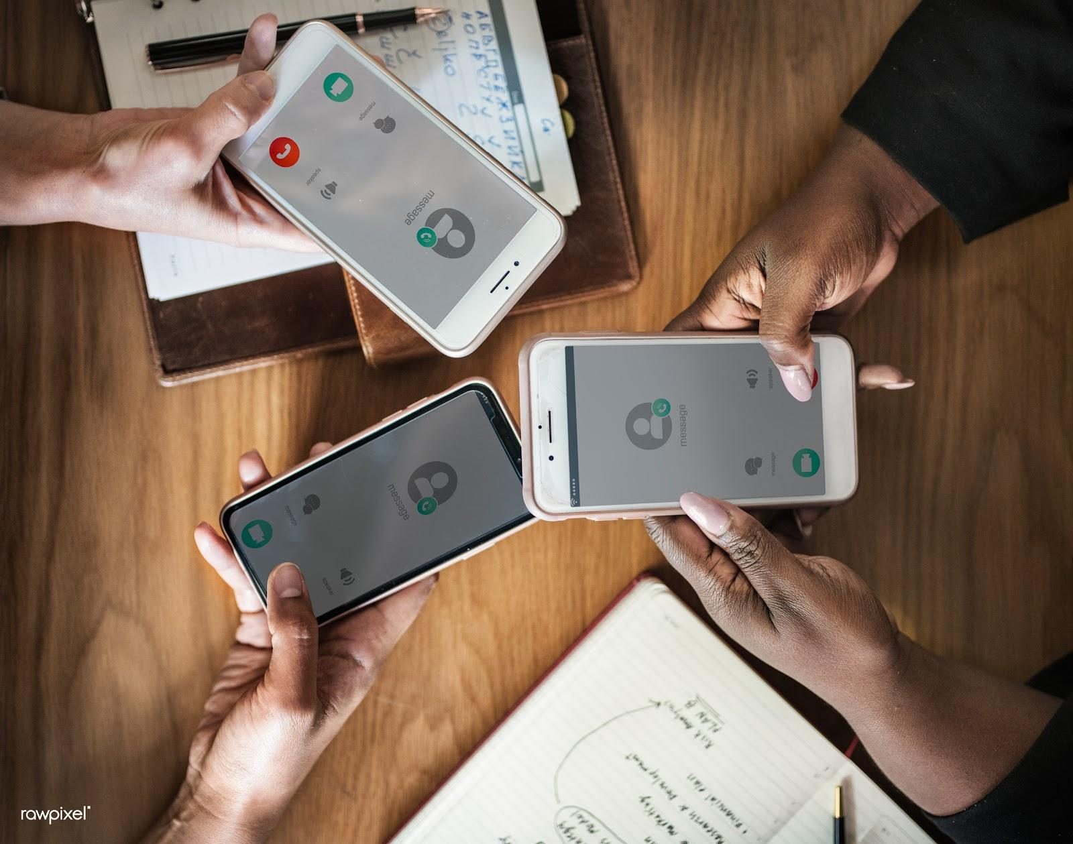

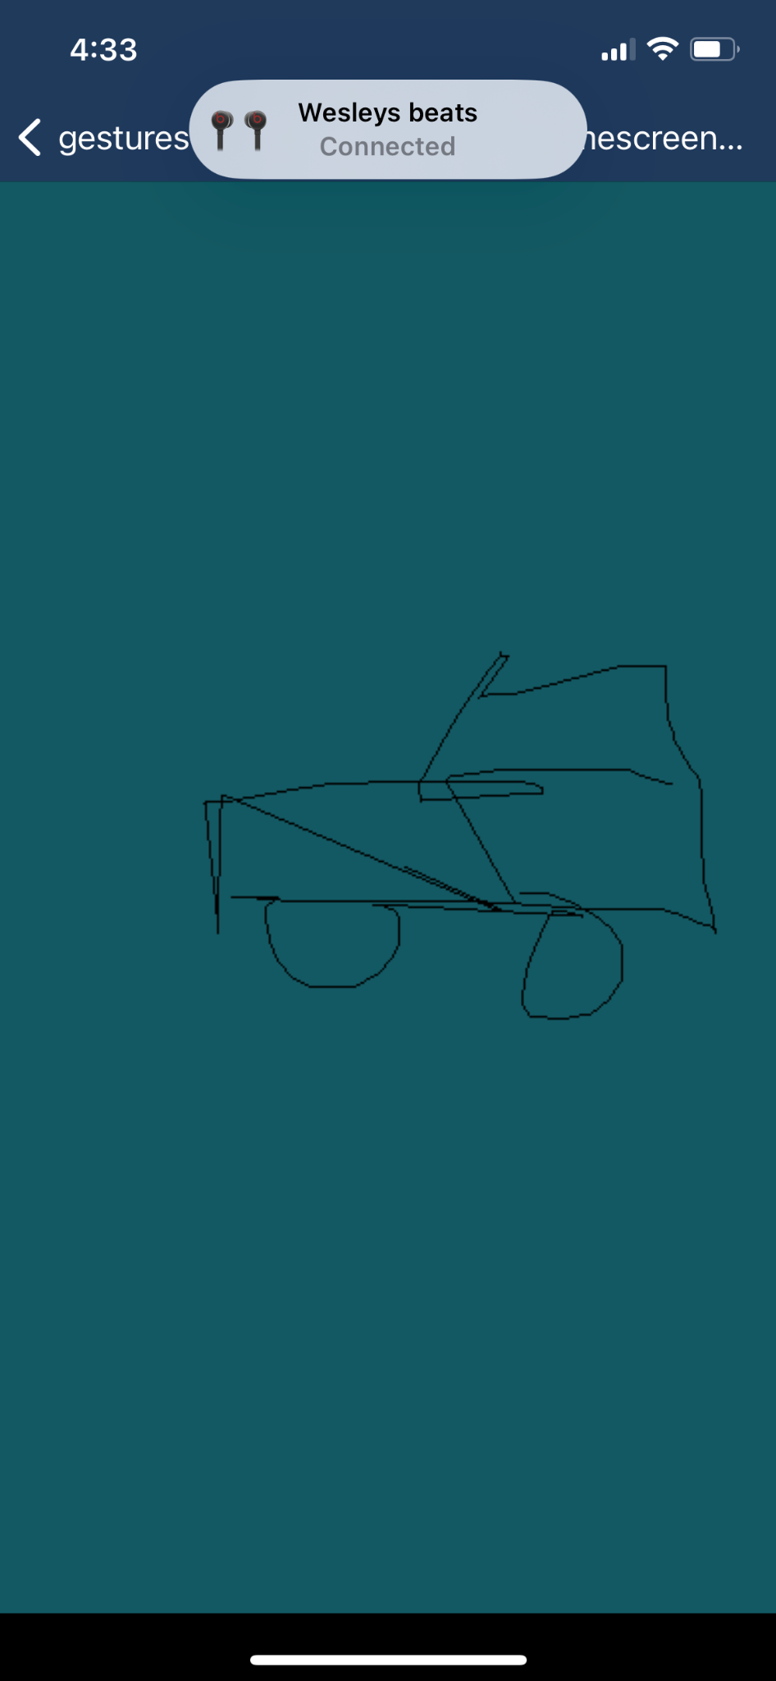
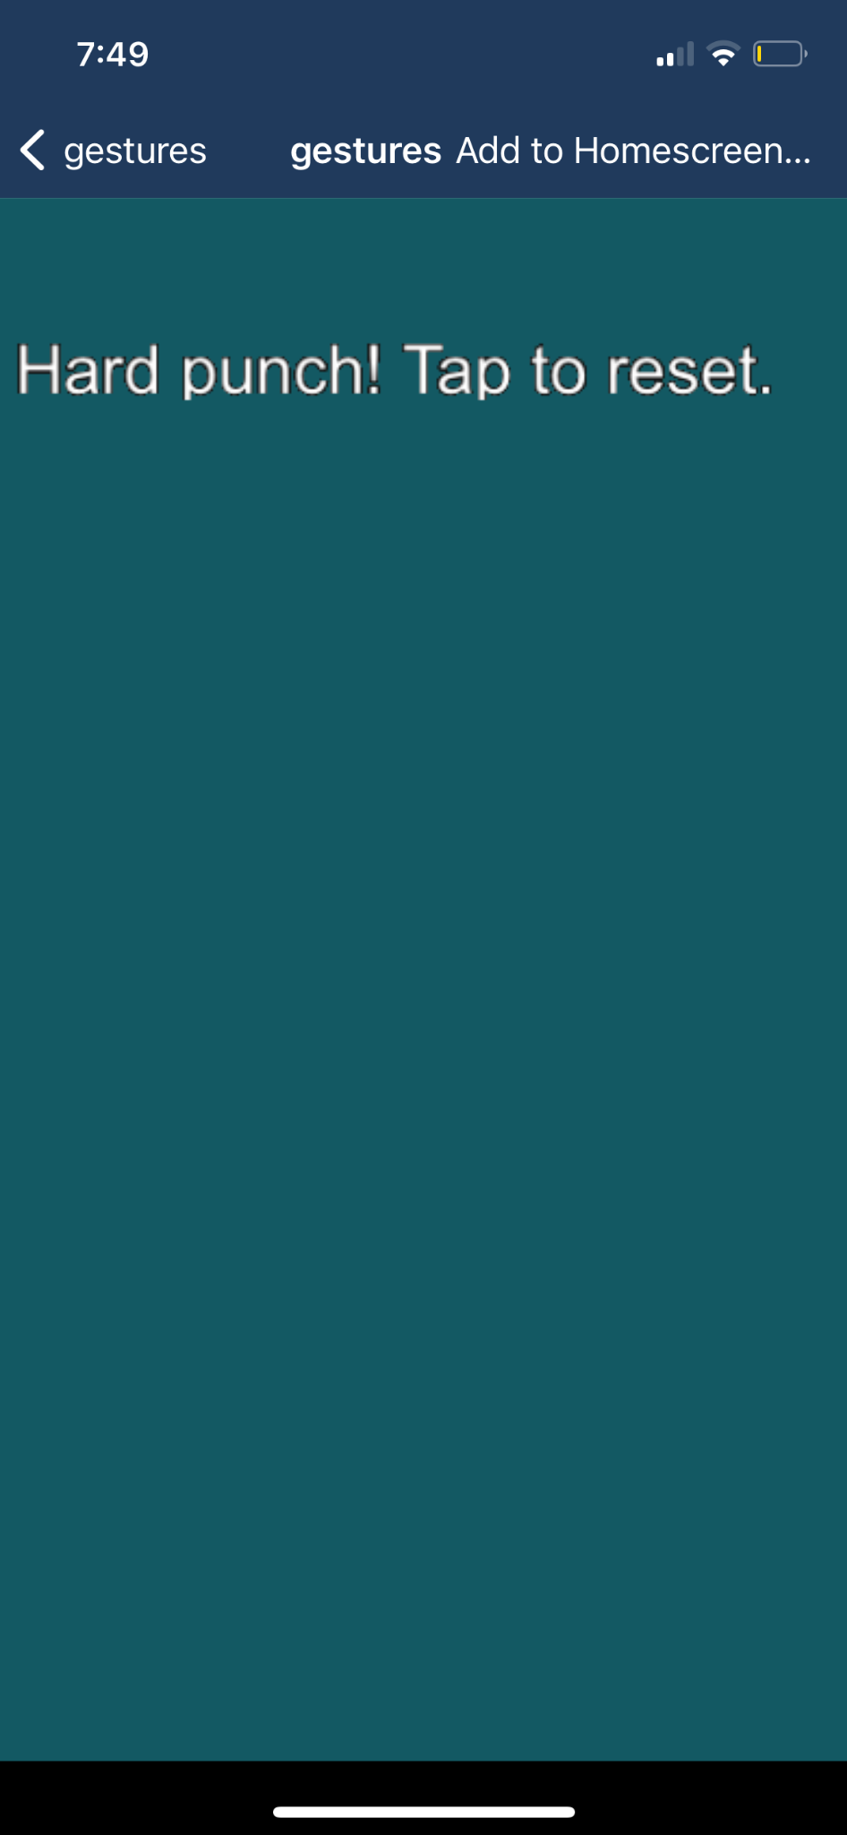
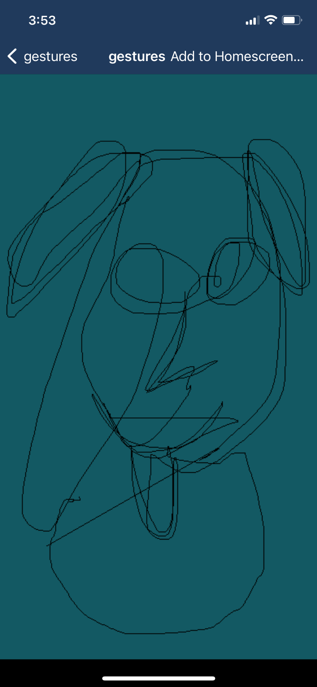
Team 5: Hard Punch and Precision Spin
Wesley, Renee, Max, Minna
Notes:
reload the timer.

Slide 2
1. apparatus

Slide 3

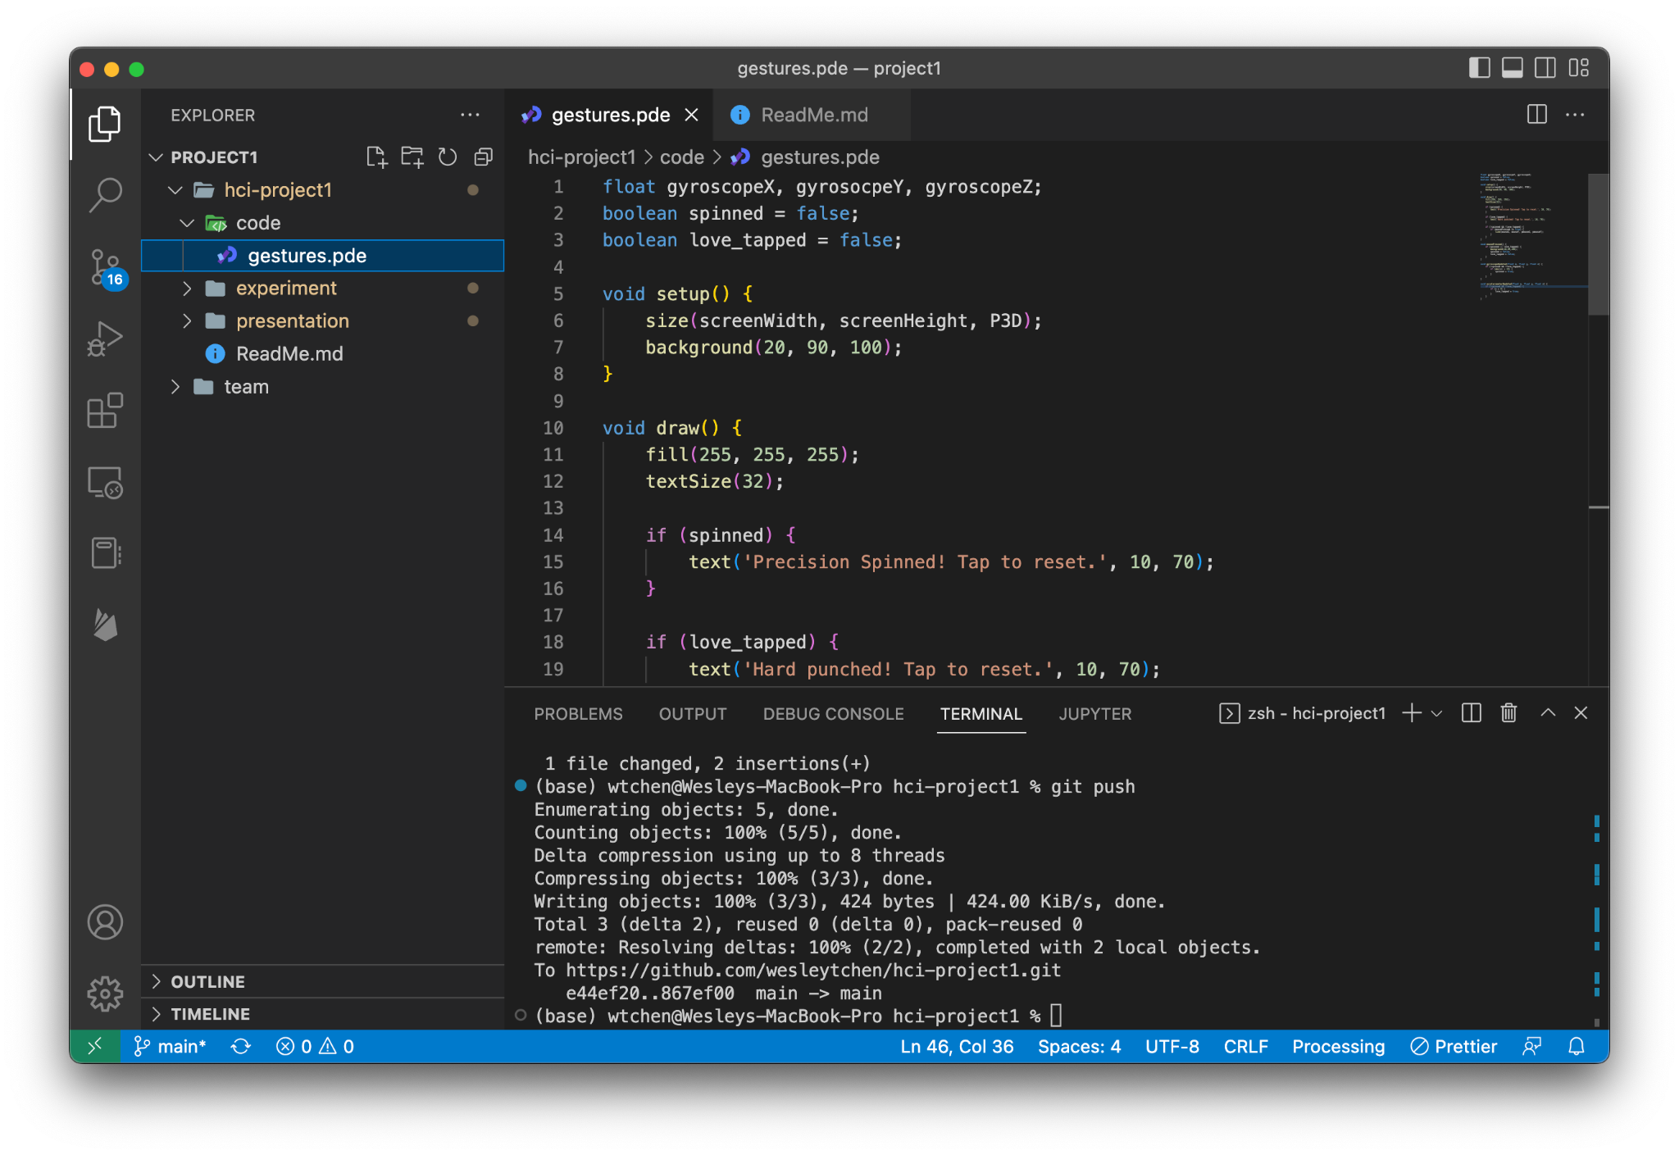
Overview
Processing for iOS

Slide 4
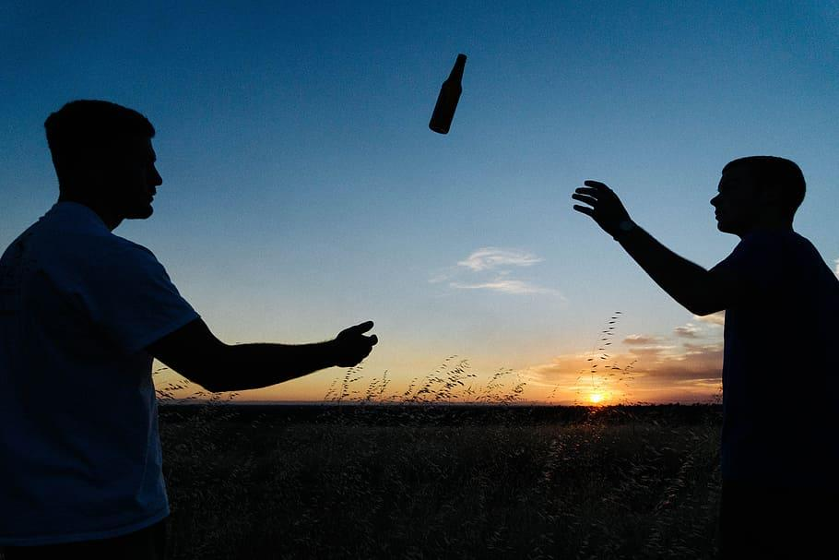
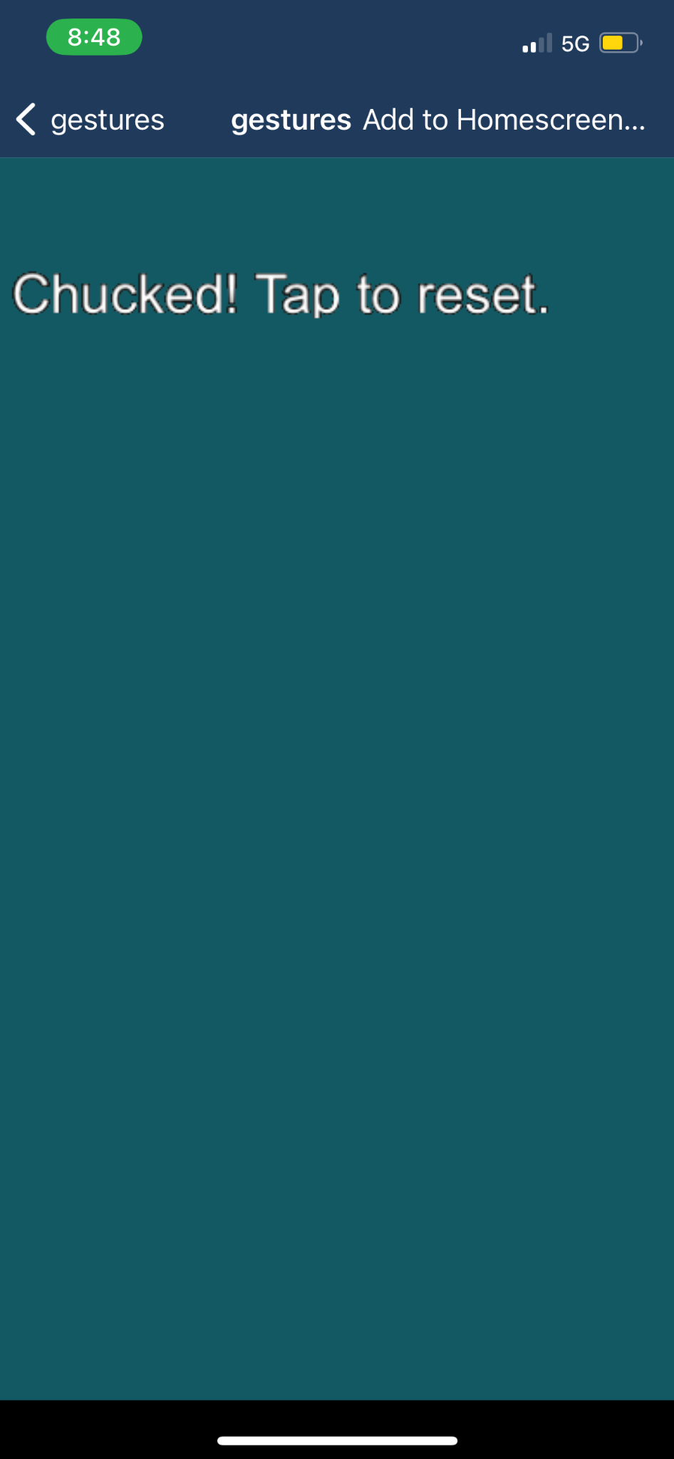
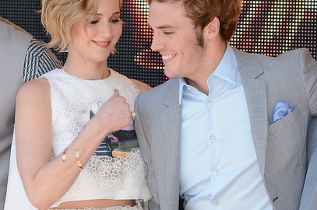
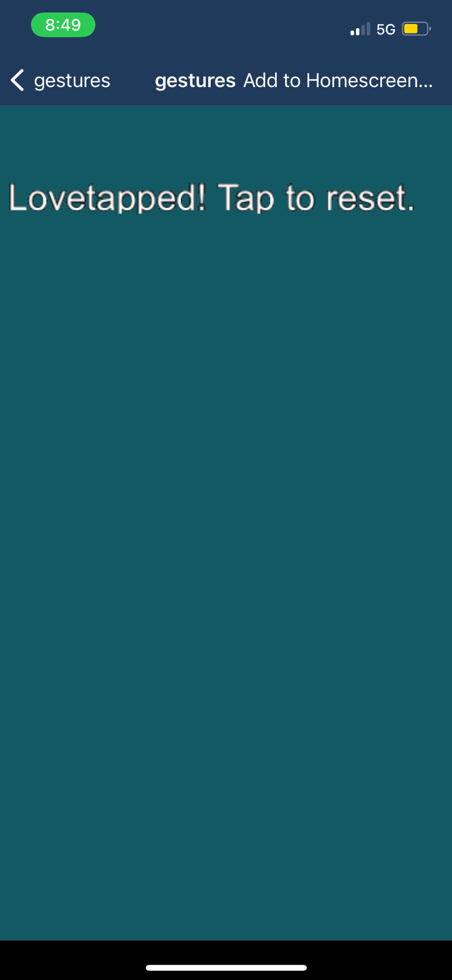
Version 1: Chucking + Lovetapping

Slide 5
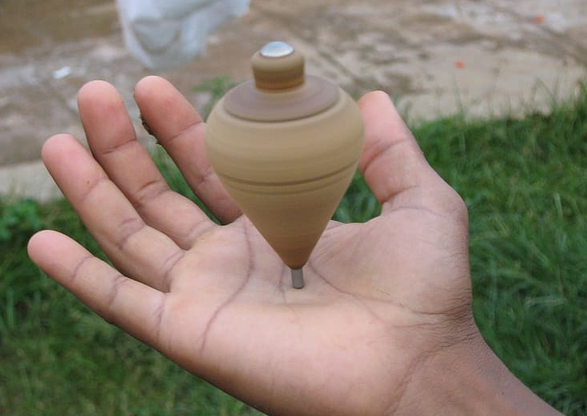
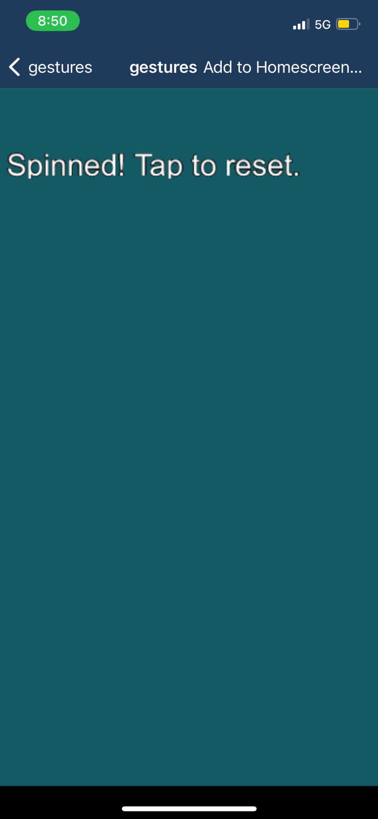
Version 2: Spinning + Lovetapping

Slide 6
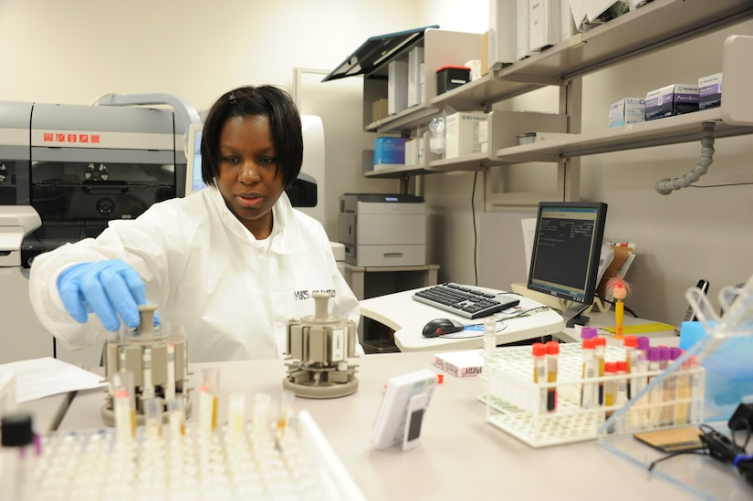
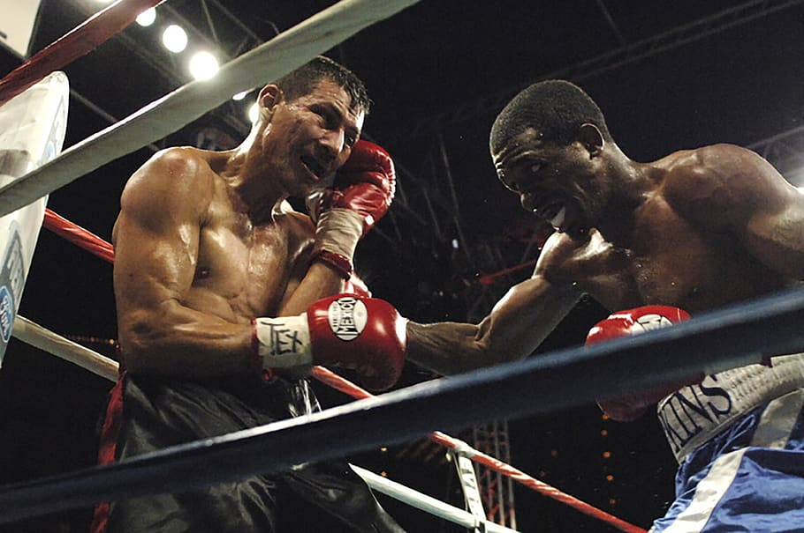
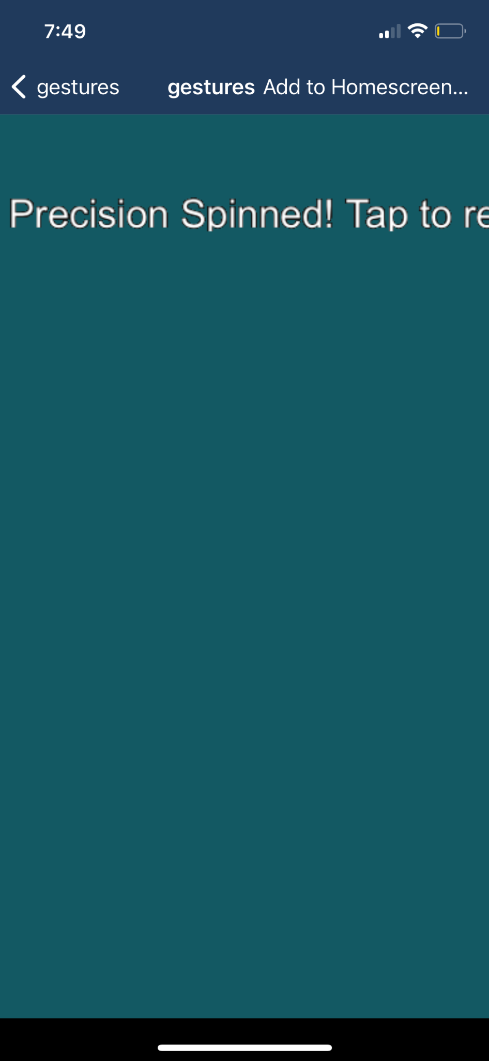
Final Version: Precision Spin + Hard Punch

Slide 7
2. study design

Slide 8
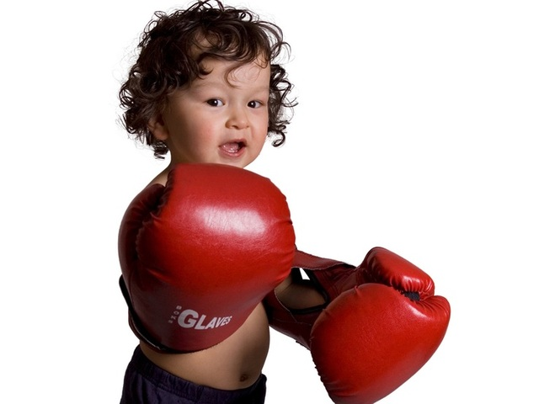
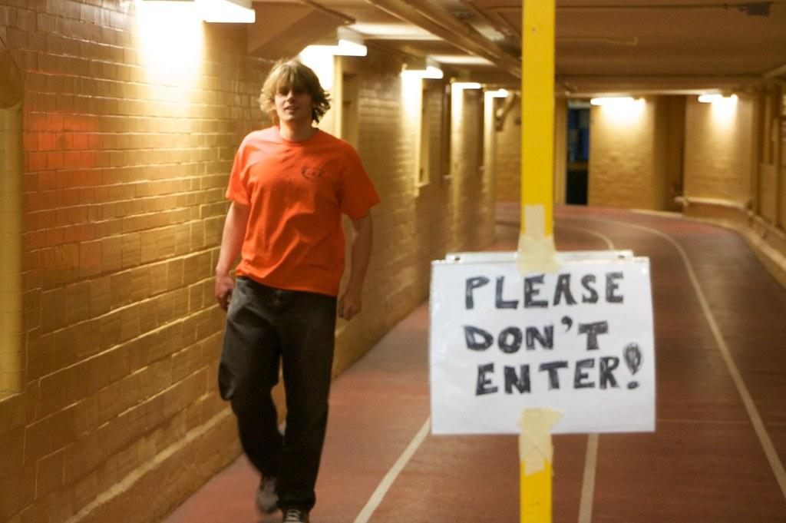
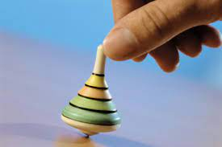
Overview: Reliability vs. Robustness
Reliability: 70% Success Rate
Robustness: Avoid accidental activation

Slide 9
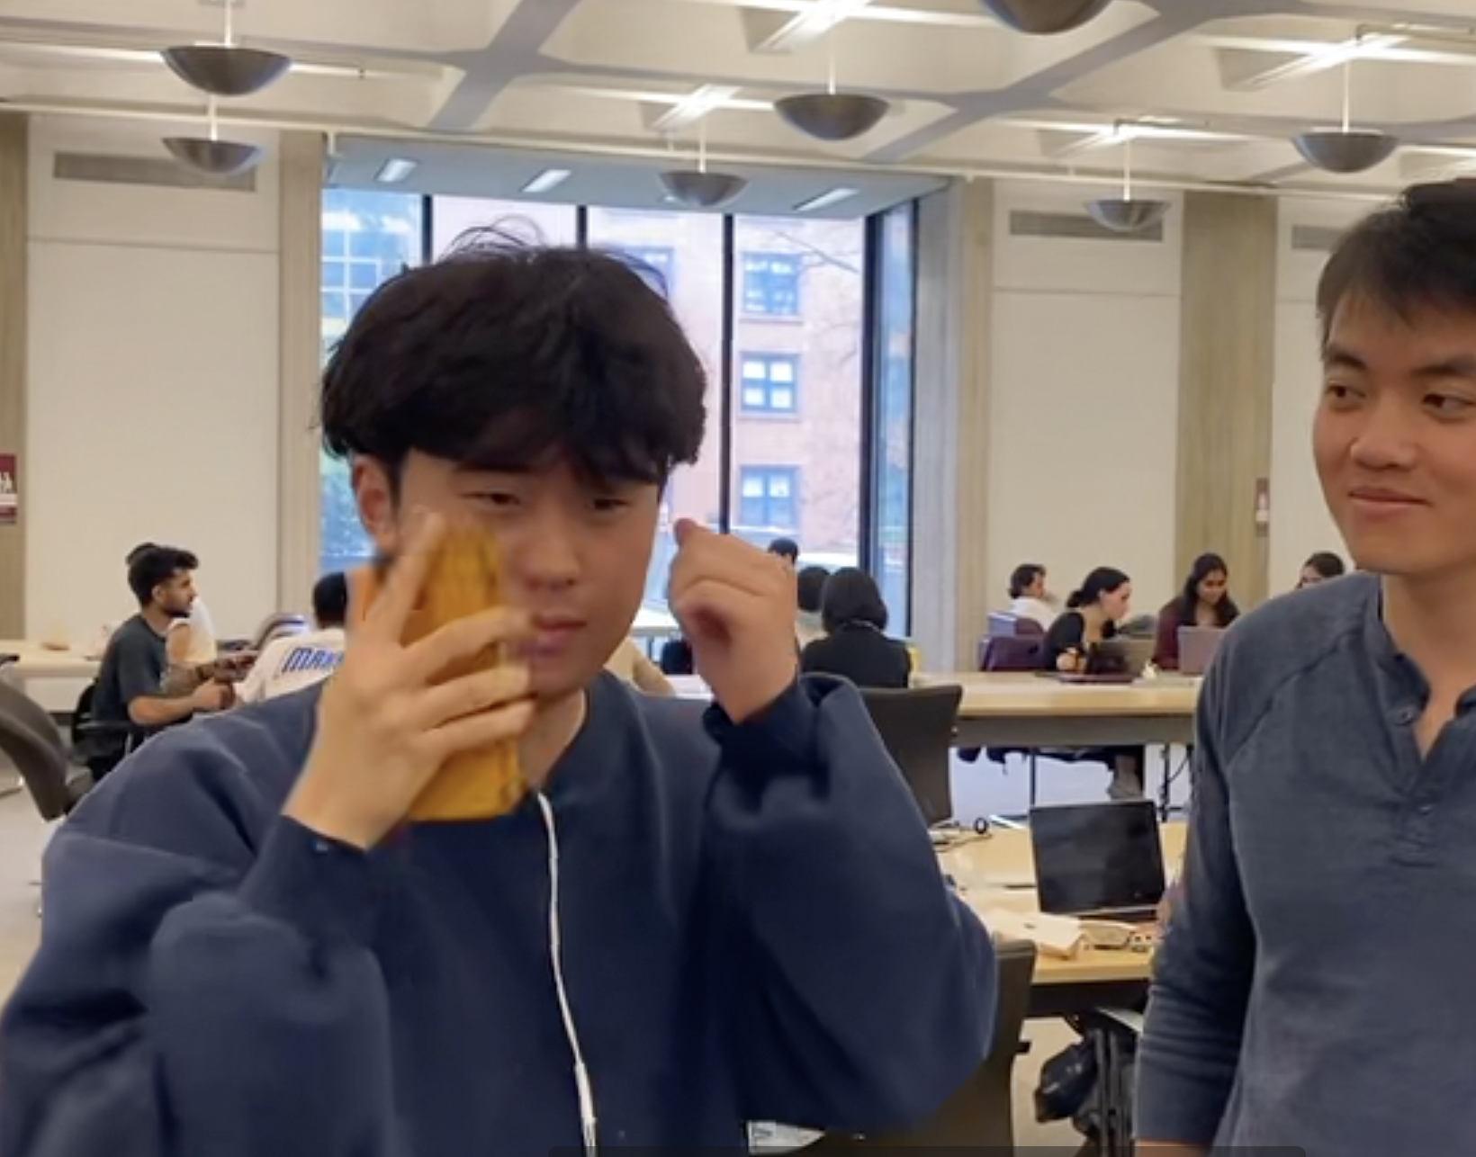
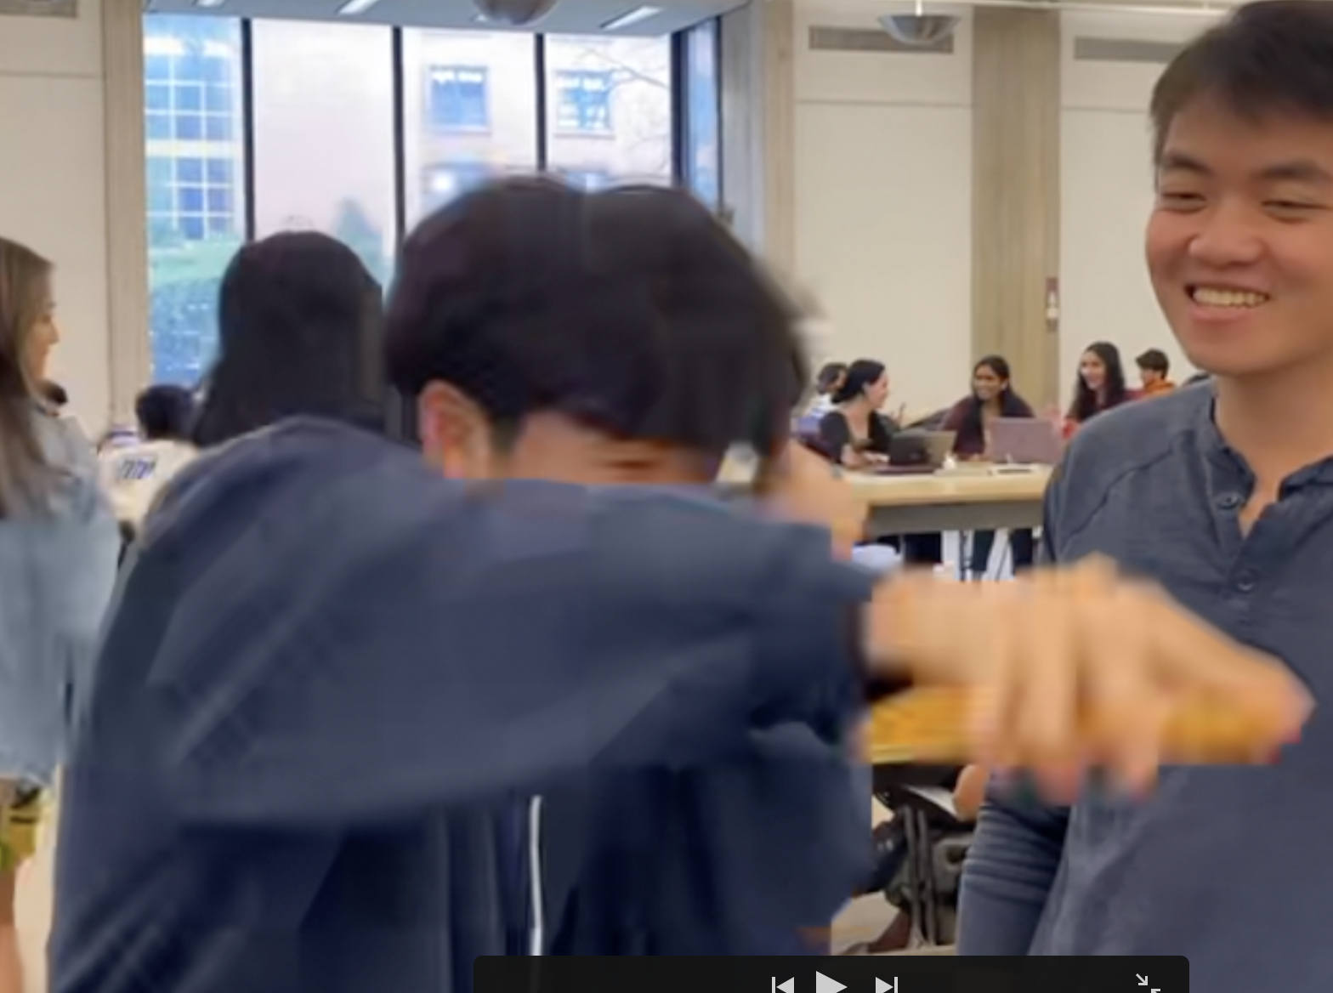
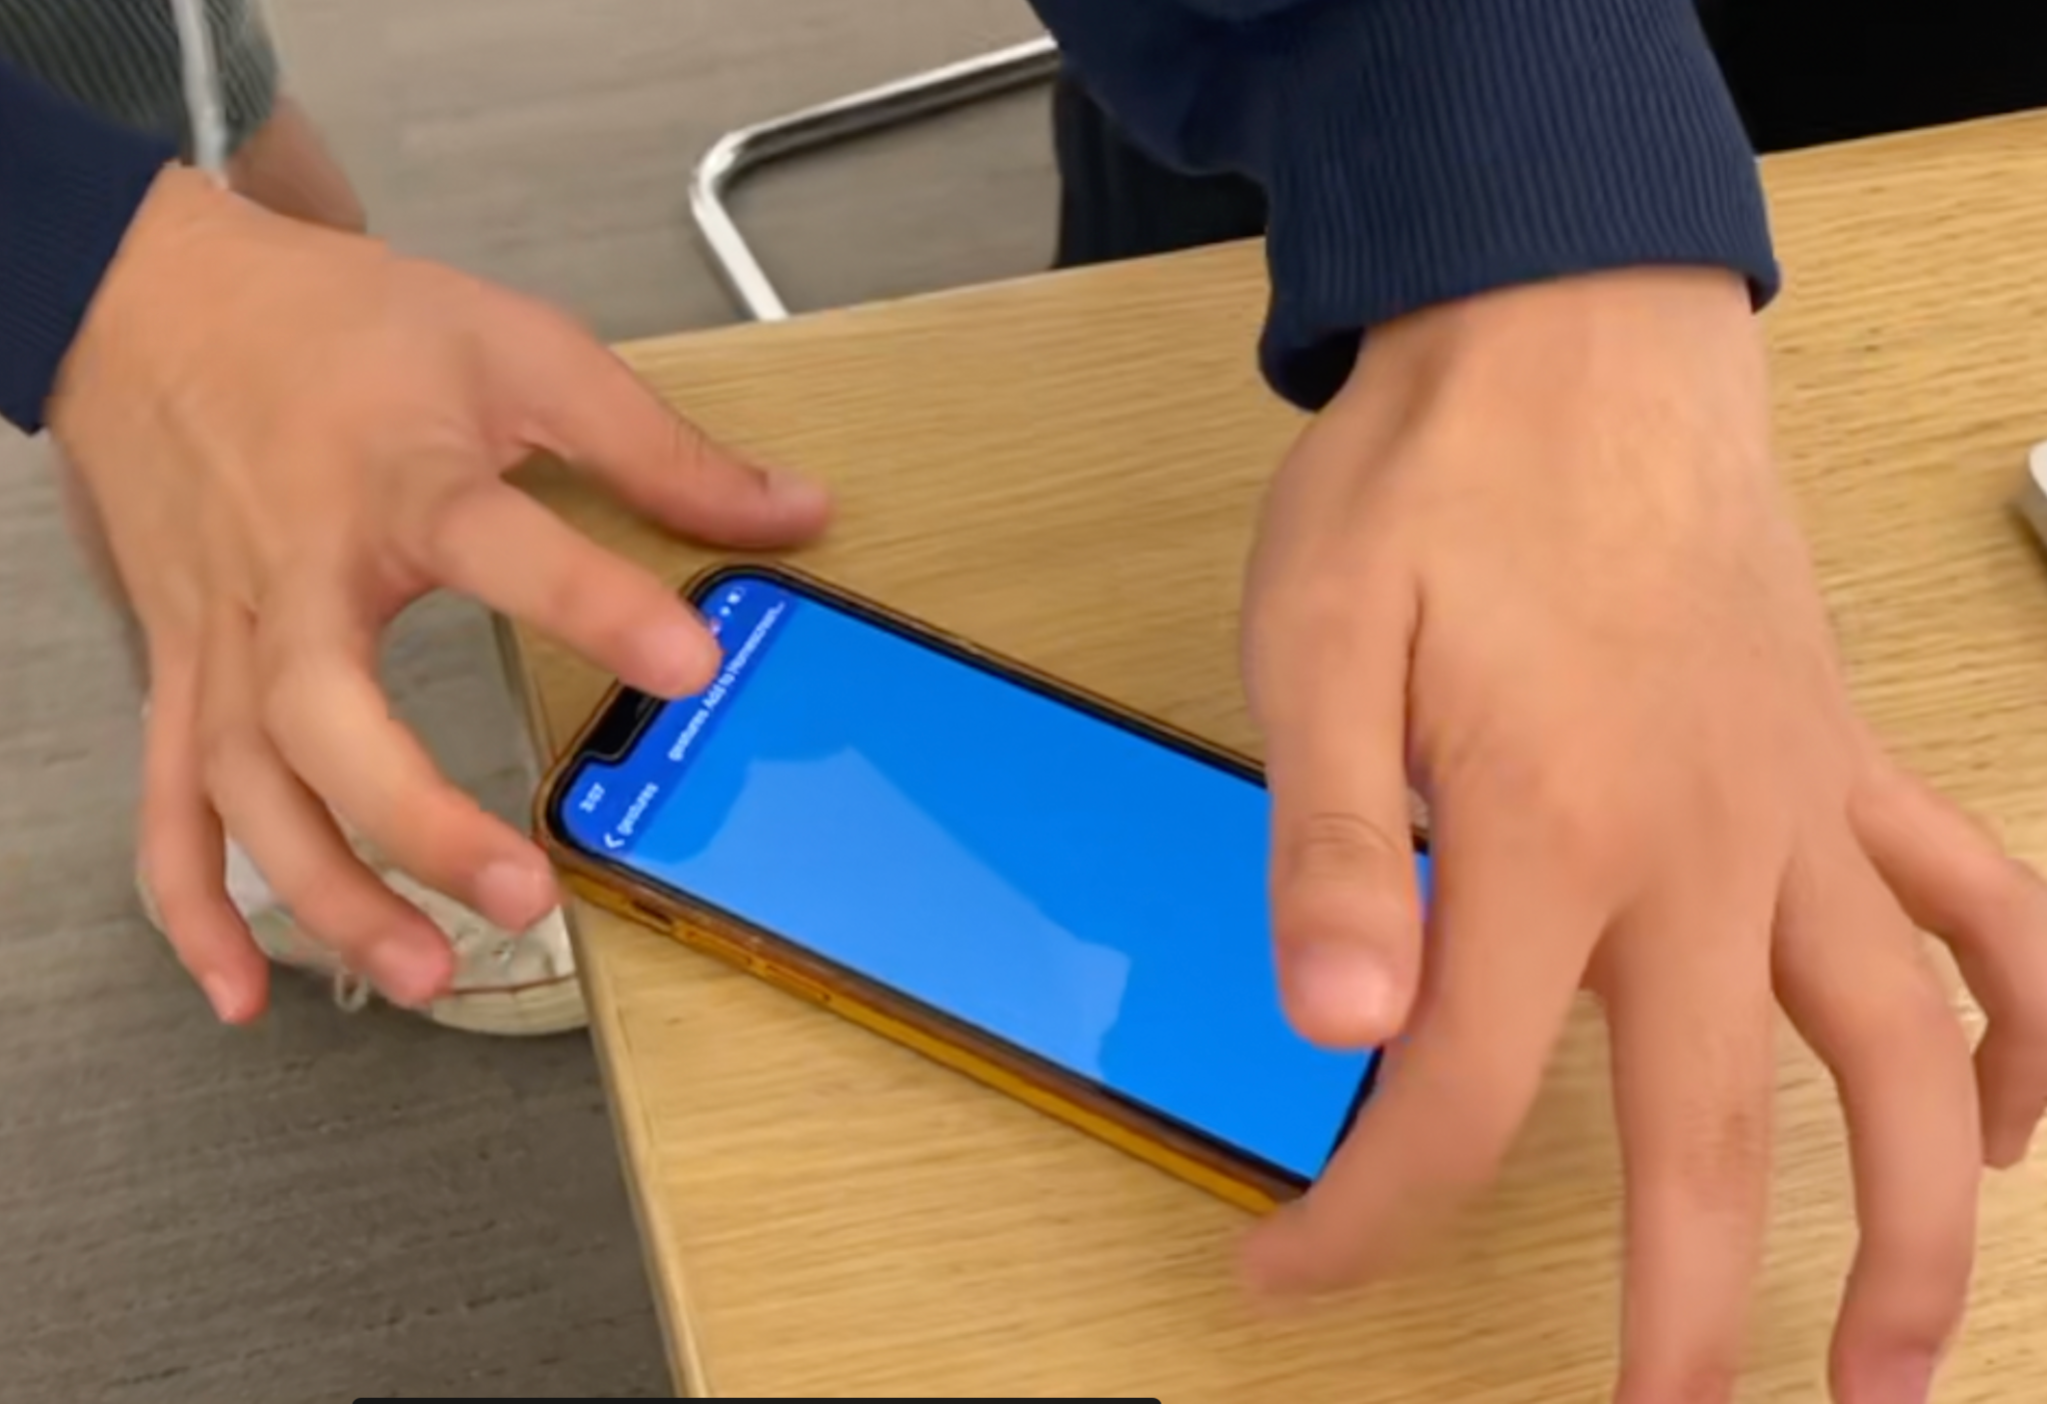
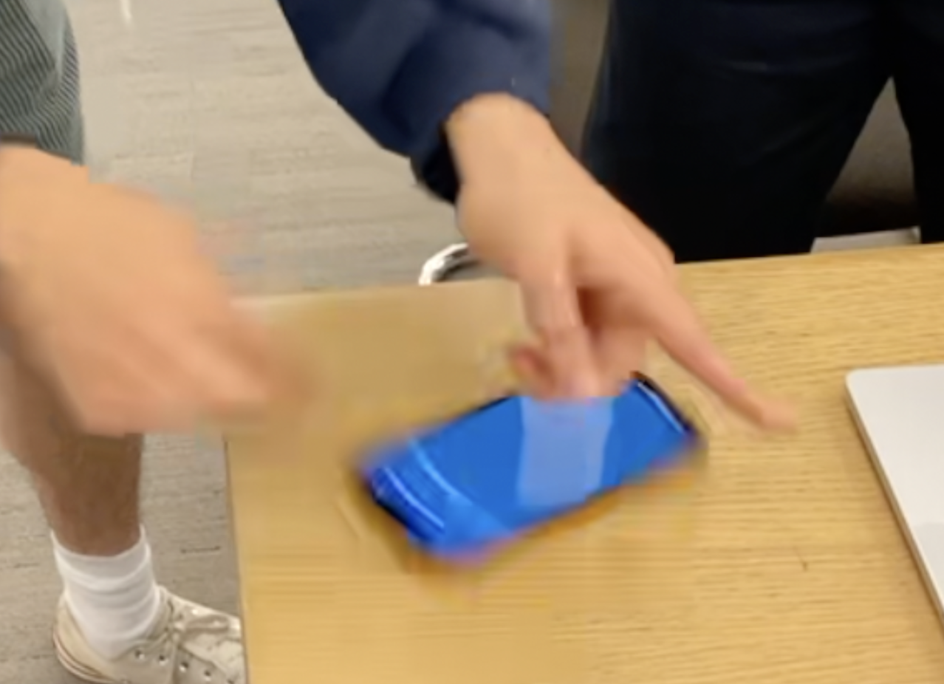
Testing Accuracy: 2 tasks
First task: After demonstrating “hard punch,” perform this action 10 times
First task: After demonstrating “precision spin,” perform this action 10 times

Slide 10
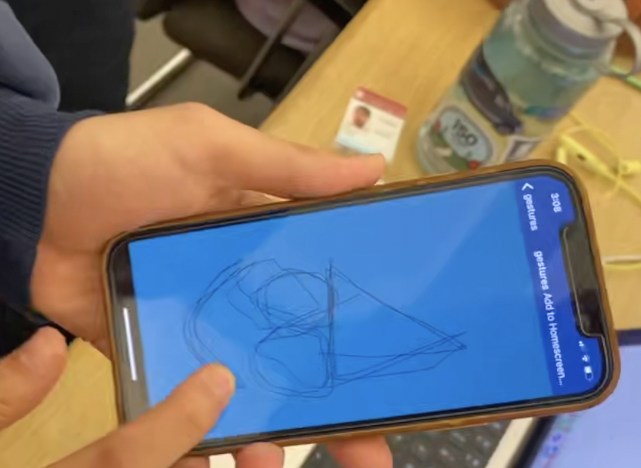
Testing Robustness
First task: Take at least 30 seconds to draw an image on the phone you would be proud of

Slide 11
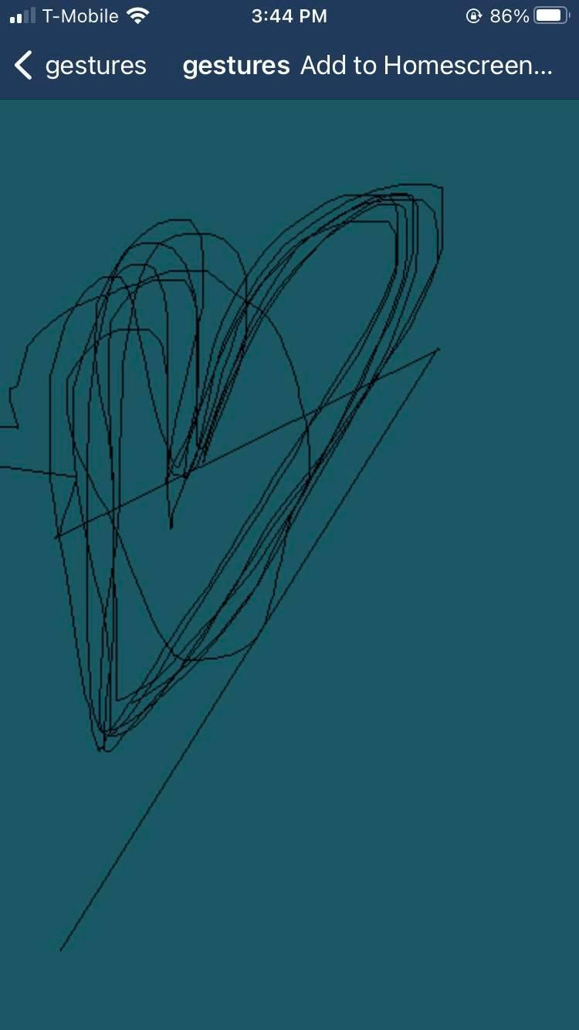
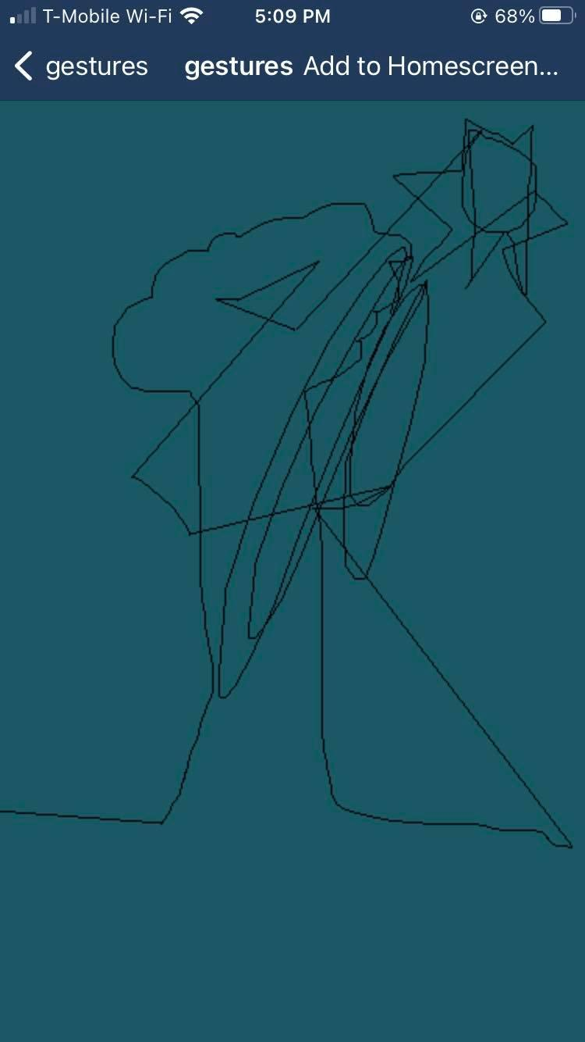
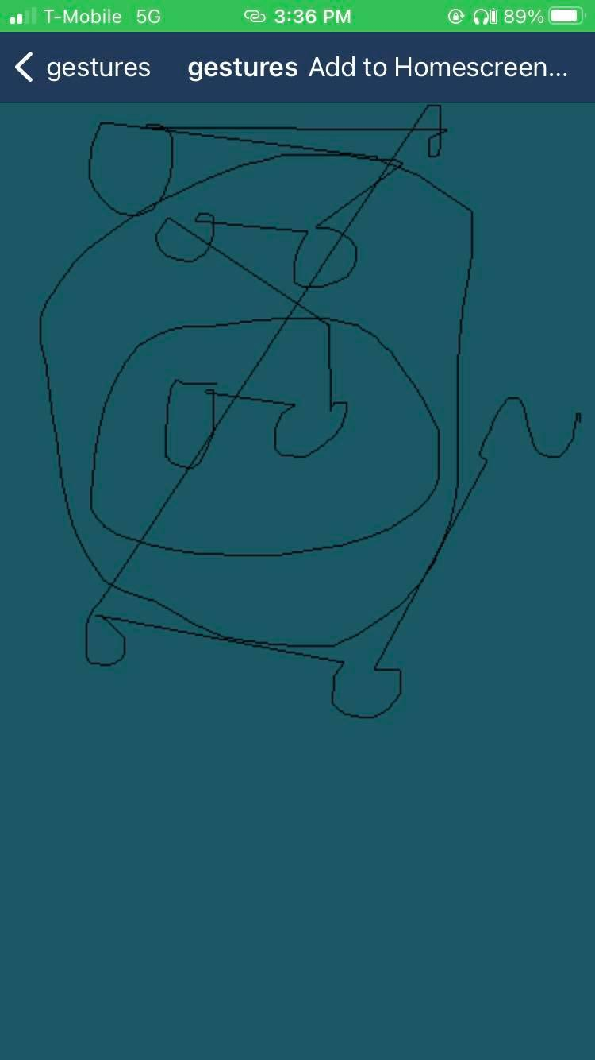
Sample drawings by our wonderful participants!

Slide 12
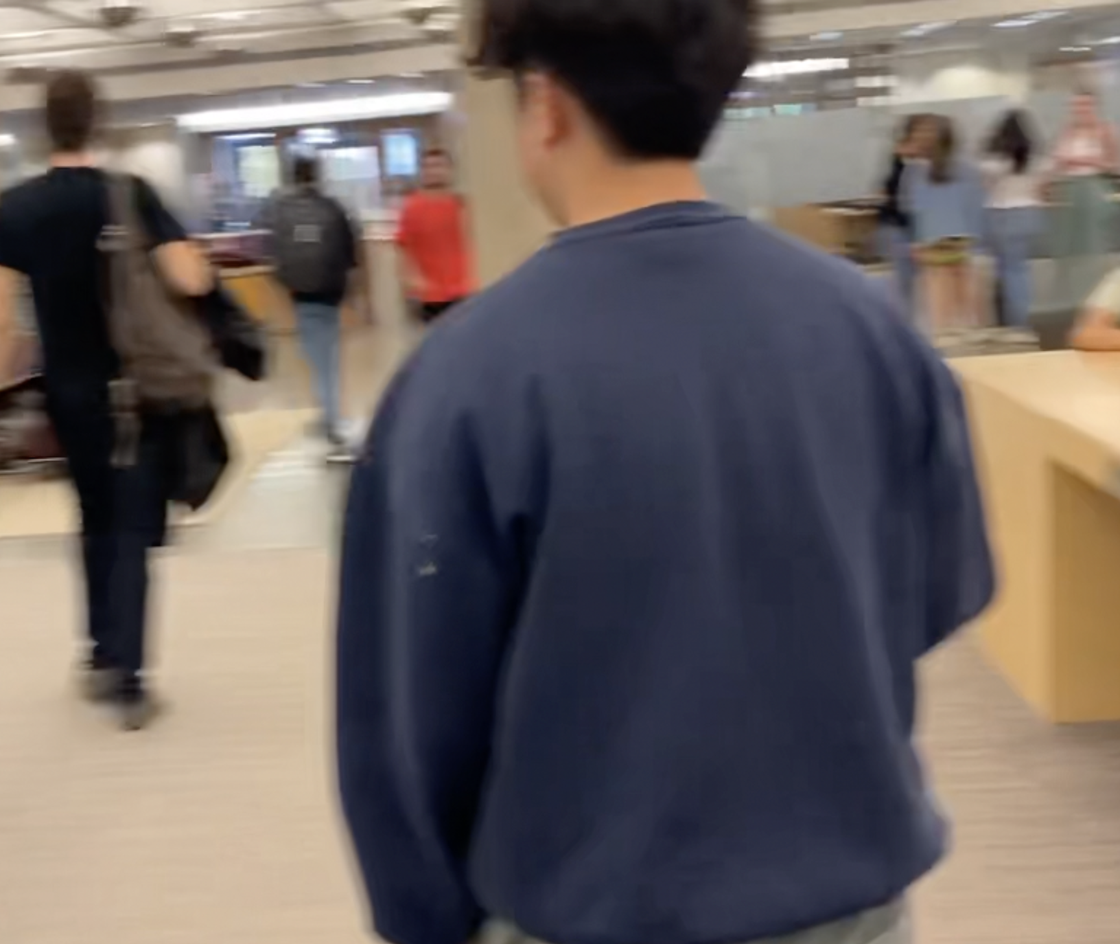
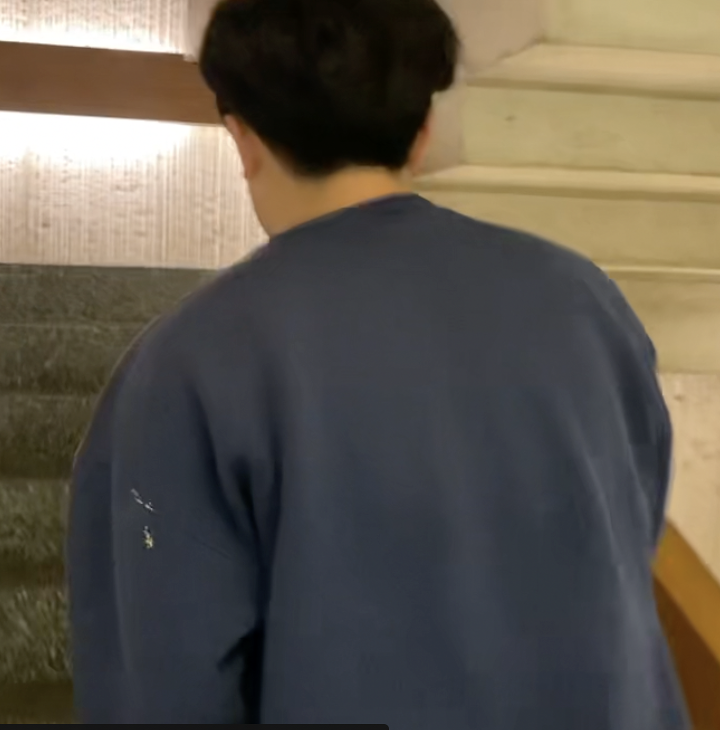
Testing Robustness
Second task: Find a water fountain to drink from, climb up/down a set of stairs, and say hi to someone

Slide 13
3. results

Slide 14
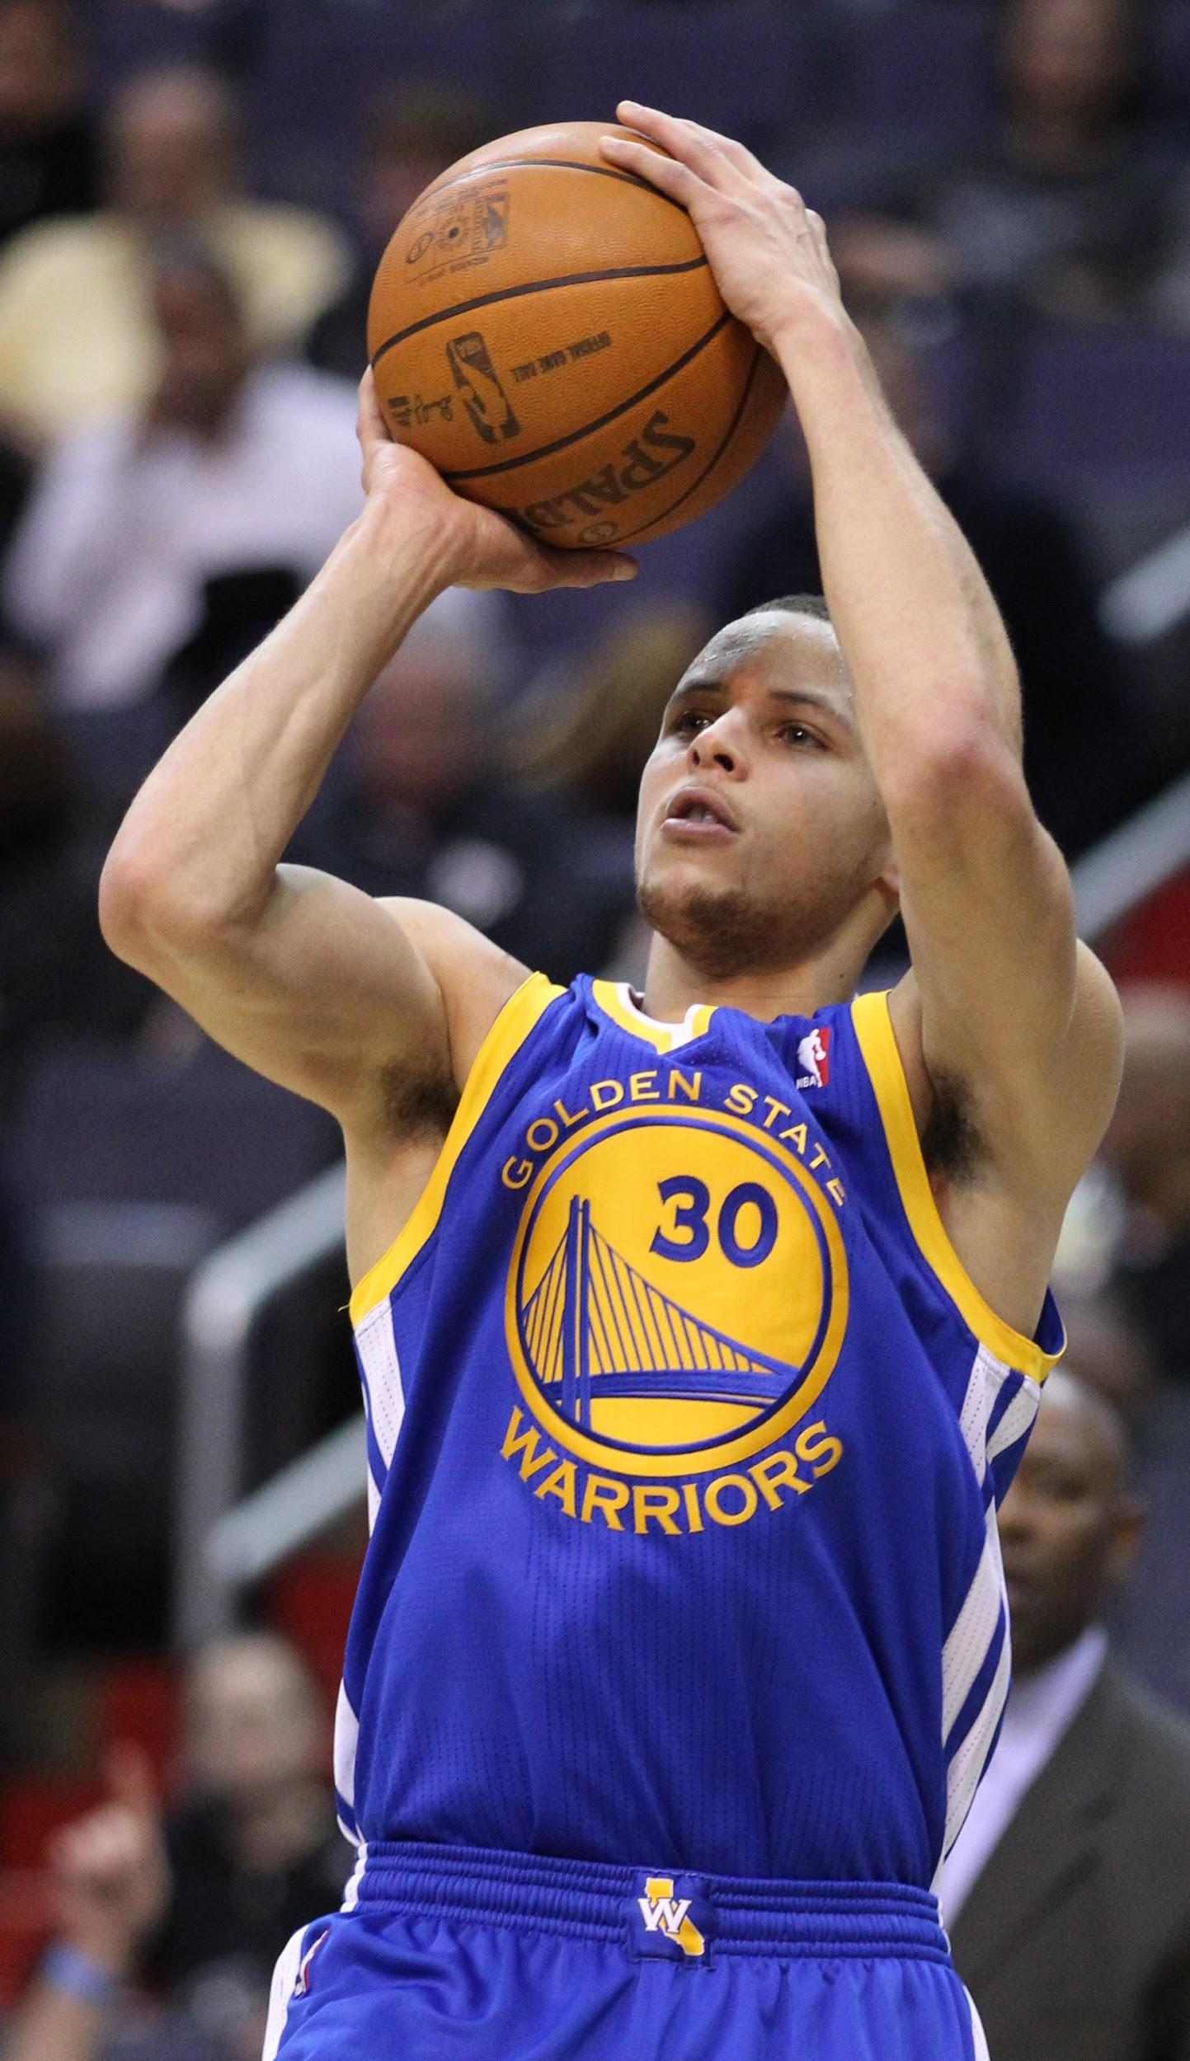
Reliability
We want 70% success rate for both gestures

Slide 15
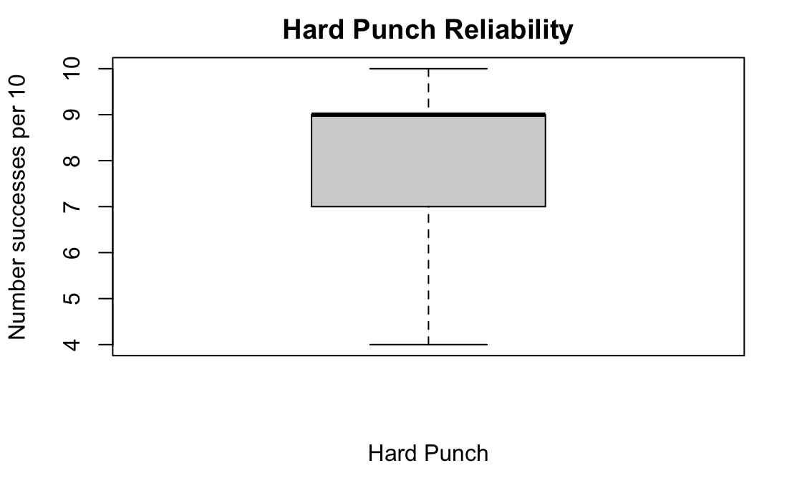
Hard Punch
H0: true mean is less than or equal to 7
HA: true mean is greater than 7
p-value = 0.0125
95 percent confidence interval: 7.35 to Inf
mean of x: 8.153846

Slide 16
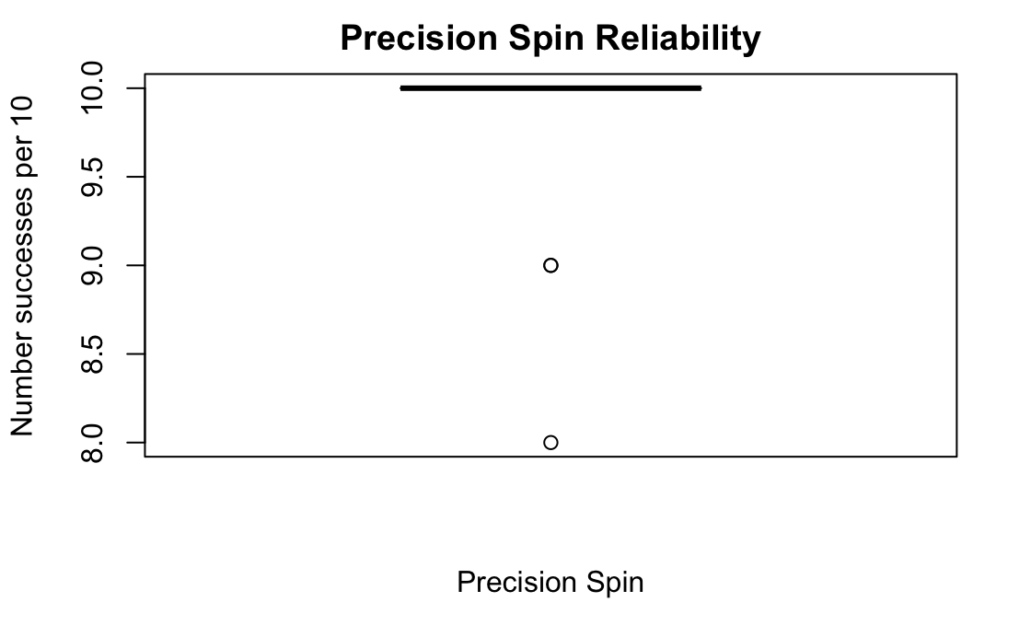
Precision Spin
H0: true mean is less than or equal to 7
HA: true mean is greater than 7
p-value ≈ 0.0000
95 percent confidence interval: 9.38 to Inf
mean of x: 9.692308

Slide 17
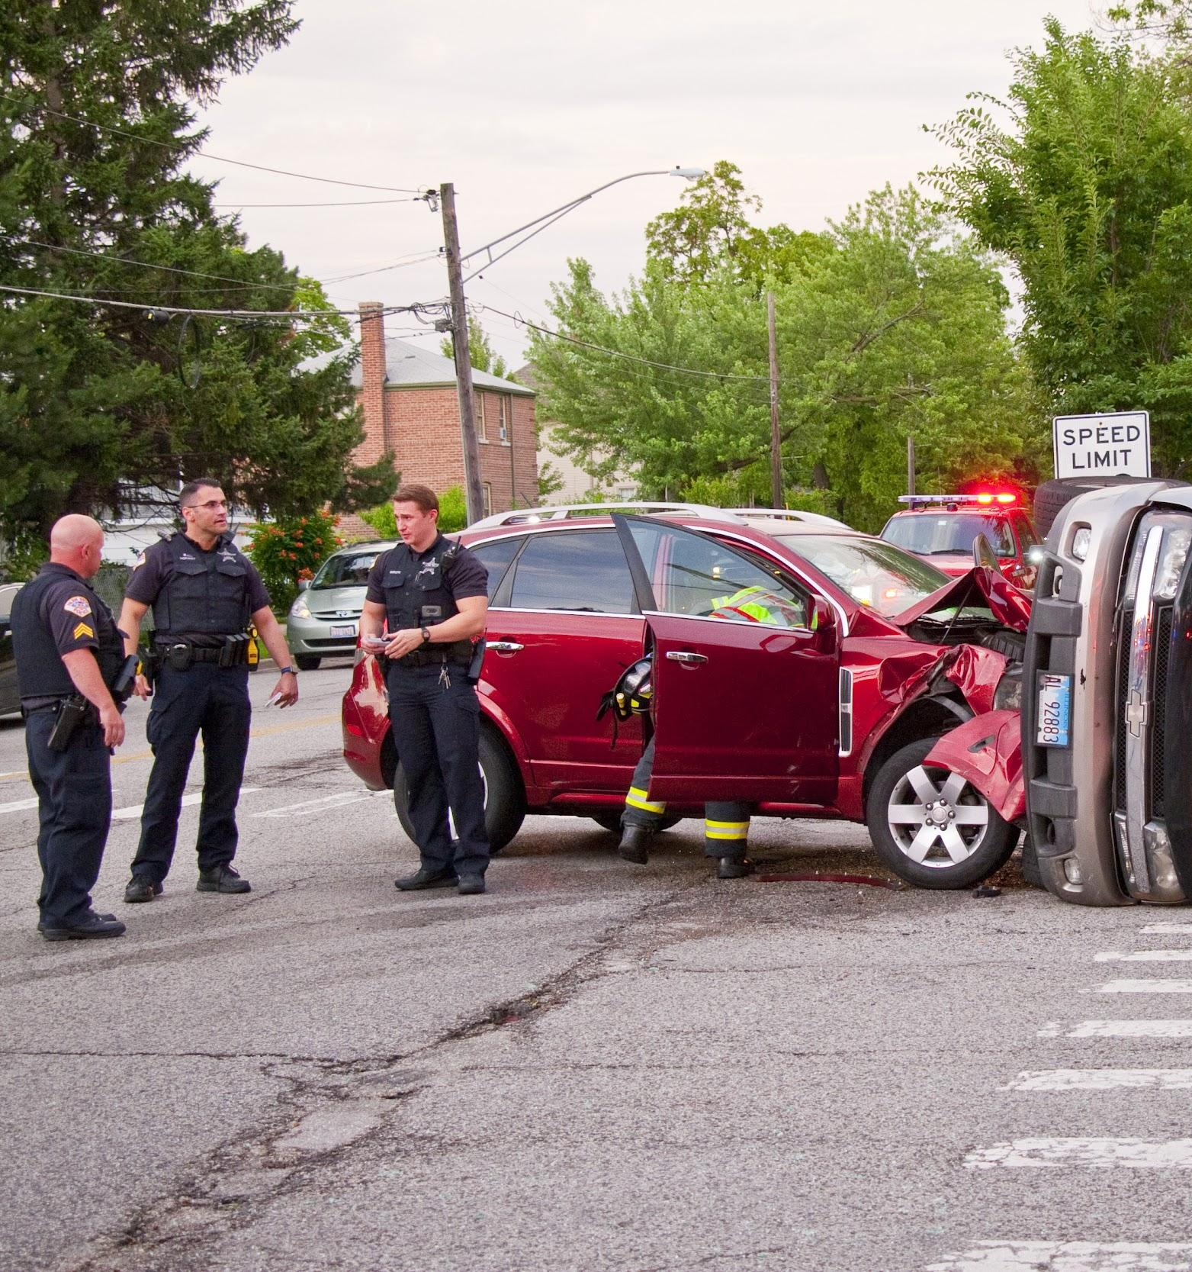
Robustness
We want 0 accidental activations, and we want to see which gesture is more robust

Slide 18
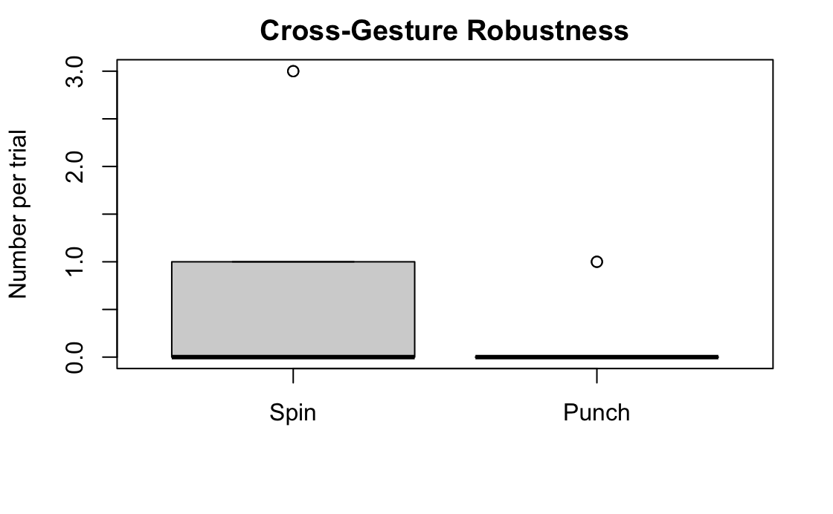
Cross-Gesture Robustness: Spin vs. Punch
H0: true difference in means is equal to 0
HA: true difference in means is not equal to 0
p-value = 0.2132
95 percent confidence interval: -1.23 to 0.30
mean of the differences: -0.46
Note: Positive is in favor of punch and negative is in favor of spin

Slide 19
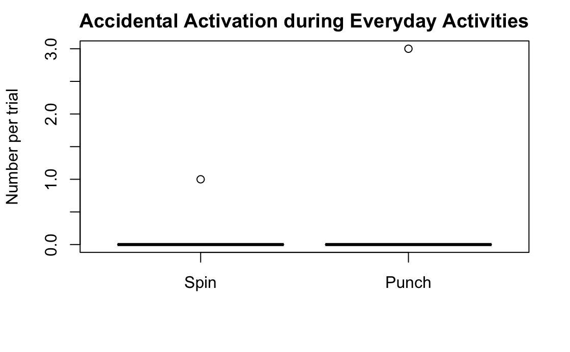
Daily Activity Robustness: Spin vs. Punch
H0: true difference in means is equal to 0
HA: true difference in means is not equal to 0
p-value = 0.5486
95 percent confidence interval: -0.39 to 0.70
mean of the differences: 0.154
Note: Negative is in favor of spin and positive is in favor of punch

Slide 20
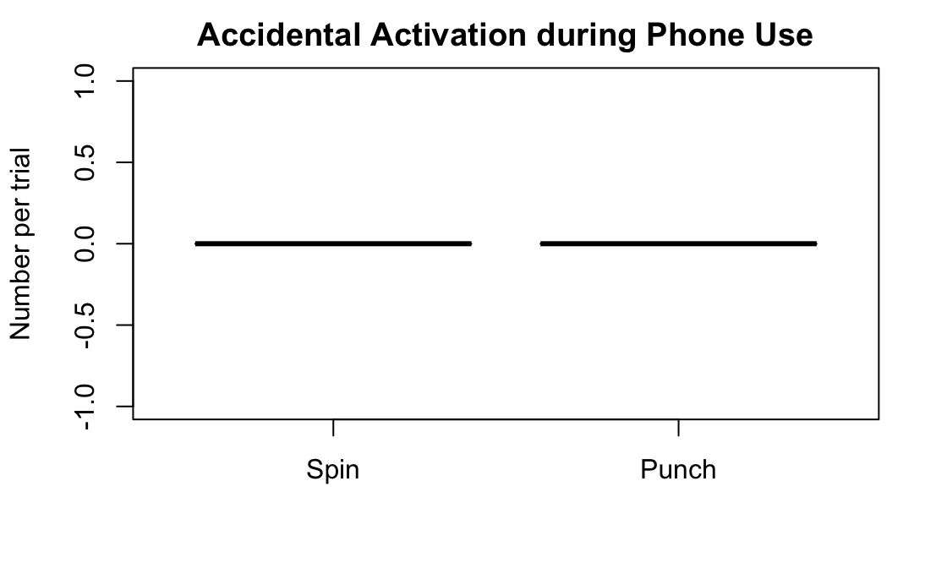
Phone Usage Robustness: Spin vs. Punch
H0: true difference in means is equal to 0
HA: true difference in means is not equal to 0
p-value = n/a
95 percent confidence interval: n/a
mean of the differences: 0
Note: Negative is in favor of spin and positive is in favor of punch

Slide 21
4. discussion

Slide 22

Conclusion
We reject the null hypothesis that either gesture is not reliable to 70% success rate
Hard punch p-score: 0.0125
Precision spin p-score: 0.0000

Slide 23
Conclusion
We cannot reject the null hypothesis that neither gesture is more robust than the other
However, hard punch seems to activate less often when trying to precision spin, while precision spin falsely activates less often during daily activities.

Slide 24
Conclusion
Both gestures are highly robust, with confidence intervals that don’t include 1 for all robustness experiments

Slide 25
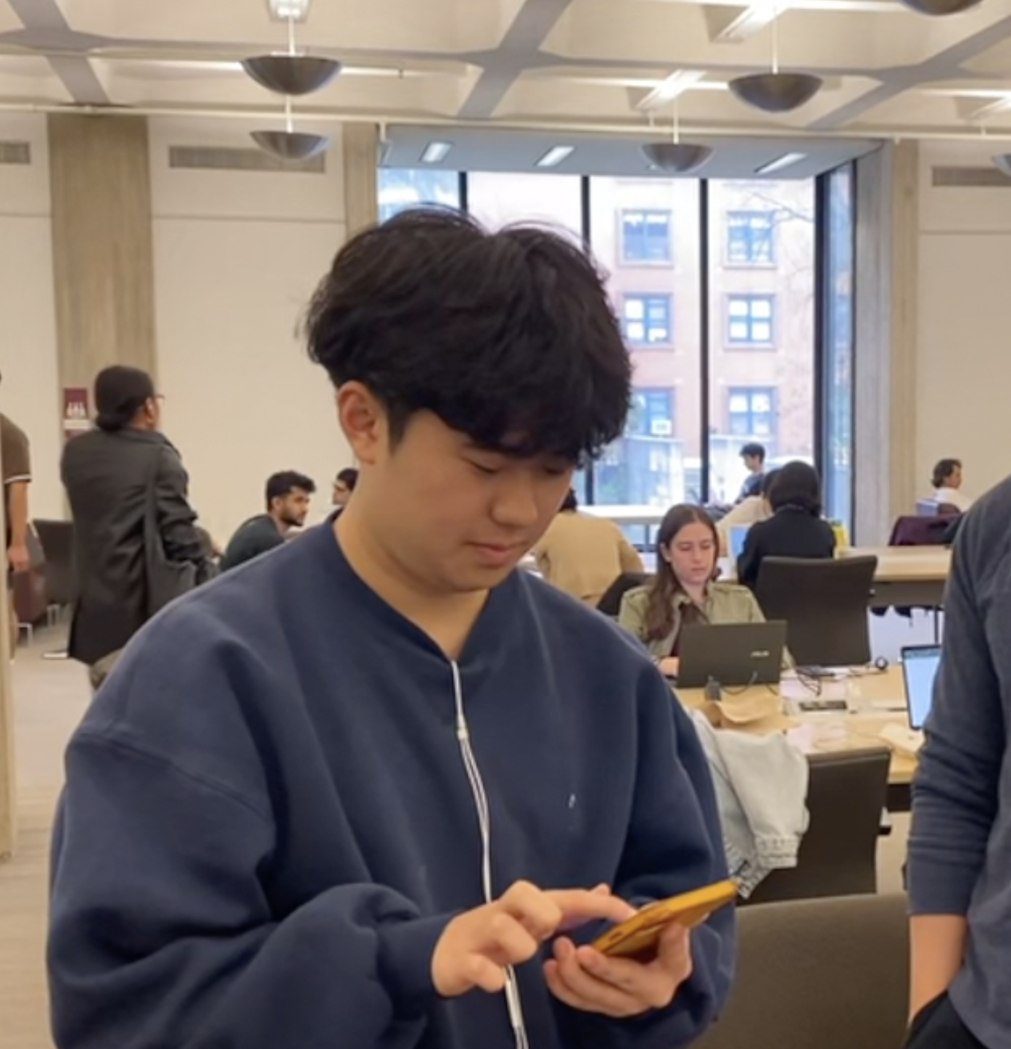
Bonus Anecdote
When participants were told to “clear the drawing” after the robustness drawing test, some intuitively understood to spin the phone or punch!

Slide 26
Team 5: Hard Punch and Precision Spin
Wesley, Renee, Max, Minna
Notes:
reload the timer.

Slide 27
5. appendices

Slide 28
Appendix A
float gyroscopeX, gyrosocpeY, gyroscopeZ;
boolean spinned = false;
boolean love_tapped = false;
void setup() {
size(screenWidth, screenHeight, P3D);
background(20, 90, 100);
}
void draw() {
fill(255, 255, 255);
textSize(32);
if (spinned) {
text('Precision Spinned! Tap to reset.', 10, 70);
}
if (love_tapped) {
text('Hard punched! Tap to reset.', 10, 70);
}
if (!spinned && !love_tapped) {
if (mousePressed == true) {
line(mouseX, mouseY, pmouseX, pmouseY);
}
}
}
void mousePressed() {
if (spinned || love_tapped) {
background(20,90,100);
spinned = false;
love_tapped = false;
}
}
void gyroscopeUpdated(float x, float y, float z) {
if (!spinned && !love_tapped) {
if (abs(z) > 15) {
spinned = true;
}
}
}
void accelerometerUpdated(float x, float y, float z) {
if (!spinned && !love_tapped) {
if (x > 3) {
love_tapped = true;
}
}
}
Project Code!

Slide 29
Appendix B
Name | hard_punch_success | spin_activation_when_expect_punch | spin_success | punch_activation_when_expect_spin | punch_activations_during_walk | punch_activations_during_draw | spin_activations_during_walk | spin_activations_during_draw | Additional notes
James Kenniff | 7 | 0 | 8 | 1 | 0 | 0 | 0 | 0 | Understood how to perform the gestures intuitively after the experiment finished.
Kiki Apple | 9 | 1 | 10 | 0 | 0 | 0 | 0 | 0
Max Gallo | 9 | 0 | 10 | 0 | 0 | 0 | 0 | 0 | Used the hard punch to clear his picture without instruction
Andy Yang | 10 | 0 | 10 | 0 | 0 | 0 | 0 | 0
Andy Liu | 9 | 0 | 10 | 0 | 3 | 0 | 0 | 0 | Walked really aggressively
Justin Chang | 8 | 0 | 10 | 0 | 0 | 0 | 0 | 0
Steph Yue | 9 | 0 | 9 | 0 | 0 | 0 | 0 | 0
Jhung Kim | 10 | 0 | 9 | 1 | 0 | 0 | 0 | 0
Jake Wei | 7 | 3 | 10 | 0 | 0 | 0 | 0 | 0
William Zeng | 8 | 1 | 10 | 0 | 0 | 0 | 0 | 0
Alicia Liu | 9 | 0 | 10 | 0 | 0 | 0 | 0 | 0
Emilie | 7 | 3 | 10 | 0 | 0 | 0 | 1 | 0
Lucas Hong | 4 | 0 | 10 | 0 | 0 | 0 | 0 | 0
Raw Data

Slide 30
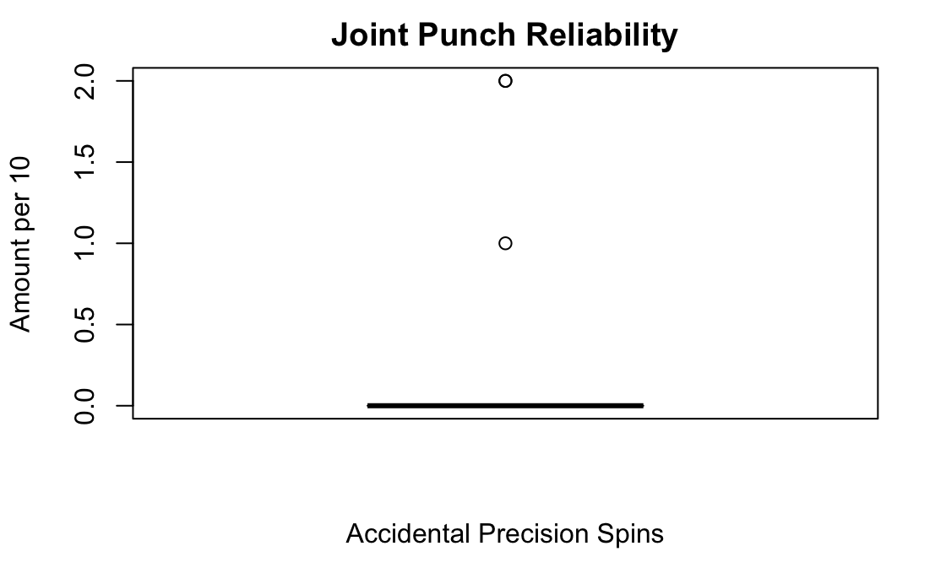
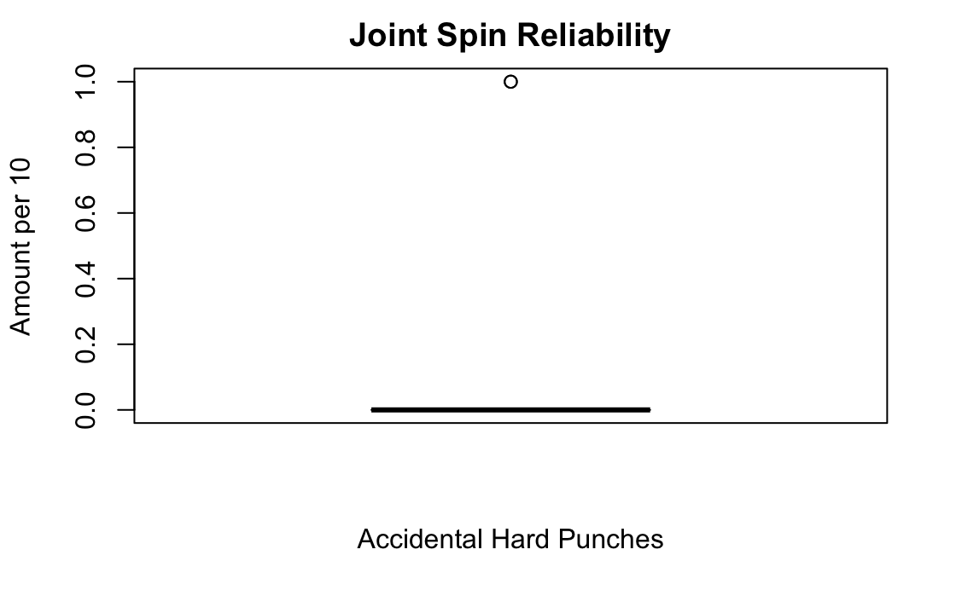
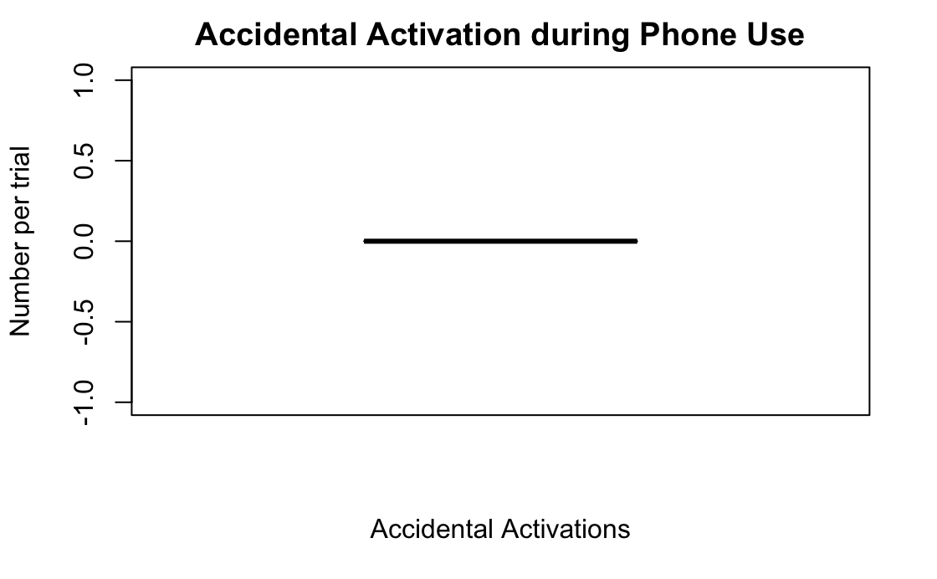
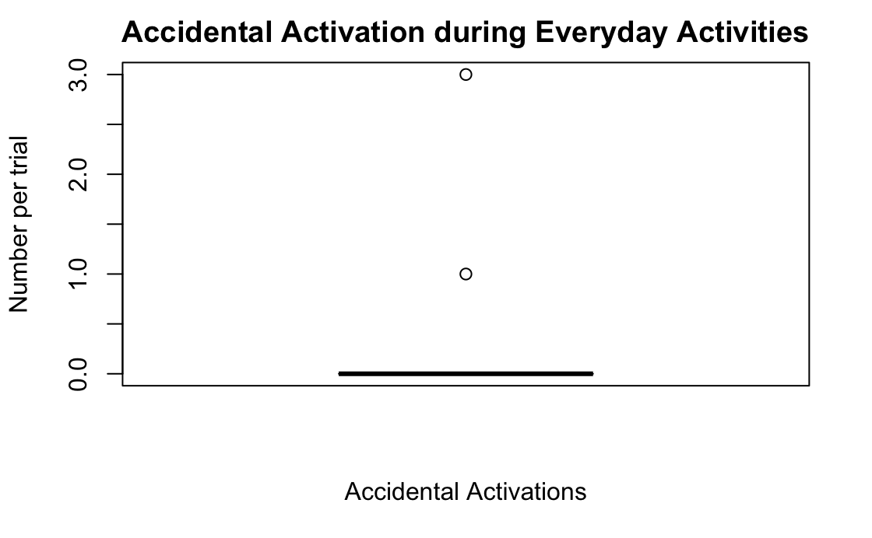
Appendix C
R Notebook
Project 1 Analysis
Import libaries and data
Hide
library("readxl")
data = read_excel("data.xlsx")
Testing that “Hard Punch” is reliable 70% of the time. Null hypothesis is that hard_punch_success <= 70%
Hide
t.test(data$hard_punch_success, alternative = "greater", mu = 7)
One Sample t-test
data: data$hard_punch_success
t = 2.56, df = 12, p-value = 0.0125
alternative hypothesis: true mean is greater than 7
95 percent confidence interval:
7.350519 Inf
sample estimates:
mean of x
8.153846
Testing that “Precision Spin” is reliable 70% of the time. Null hypothesis is that spin_success <= 70%
Hide
t.test(data$spin_success, alternative = "greater", mu = 7)
One Sample t-test
data: data$spin_success
t = 15.398, df = 12, p-value = 1.44e-09
alternative hypothesis: true mean is greater than 7
95 percent confidence interval:
9.380677 Inf
sample estimates:
mean of x
9.692308
Testing that we don’t have false activations of “Hard Punch” when performing “Precision Spin”. Testing that we don’t have false activations of “Precision Spin” when performing “Hard Punch”.
Two sample T-test
Hide
t.test(x=data$punch_activation_when_expect_spin, y= data$spin_activation_when_expect_punch, paired=TRUE)
Paired t-test
data: data$punch_activation_when_expect_spin and data$spin_activation_when_expect_punch
t = -0.89776, df = 12, p-value = 0.387
alternative hypothesis: true difference in means is not equal to 0
95 percent confidence interval:
-0.7908341 0.3292957
sample estimates:
mean of the differences
-0.2307692
Testing that we don’t have false activations when walking.
Two-sample T-test
Hide
t.test(x=data$punch_activations_during_walk, y= data$spin_activations_during_walk, paired=TRUE)
Paired t-test
data: data$punch_activations_during_walk and data$spin_activations_during_walk
t = 0.61721, df = 12, p-value = 0.5486
alternative hypothesis: true difference in means is not equal to 0
95 percent confidence interval:
-0.3892431 0.6969354
sample estimates:
mean of the differences
0.1538462
Testing that we don’t have false activations when drawing. Two sample T-test
Hide
t.test(x=data$punch_activations_during_draw, y= data$spin_activations_during_draw, paired=TRUE)
Boxplot section
Hide
boxplot(data$hard_punch_success, main="Hard Punch Reliability",
xlab = "Hard Punch", ylab="Number successes per 10")
Hide
boxplot(data$spin_success, main="Precision Spin Reliability",
xlab = "Precision Spin", ylab="Number successes per 10")
Hide
boxplot(data$spin_activation_when_expect_punch, main="Joint Punch Reliability",
xlab = "Accidental Precision Spins", ylab="Amount per 10")
Hide
boxplot(data$punch_activation_when_expect_spin, main="Joint Spin Reliability",
xlab = "Accidental Hard Punches", ylab="Amount per 10")
Hide
boxplot(data$activations_during_walk, main="Accidental Activation during Everyday Activities",
xlab = "Accidental Activations", ylab="Number per trial")
Hide
boxplot(data$activations_during_draw, main="Accidental Activation during Phone Use",
xlab = "Accidental Activations", ylab="Number per trial")

